Slide 1
Weekly Report
Wangwon Lee, 2019/04/13
This week | Next week
Visualization Activation Maximization Evaluate (Implement) Evaluate (Softmax) Evaluate (Softmax to Linear) | Visualization Apply 1-D model More clearly The other model(tanh, long filter) The other label CAM(Class Activation Map)
Interesting and new finding
Visualization Activation Maximization
The aim of this month / Discussion
The aim of this month: To investigate about CNN and visualization.
Notes:
I want you to follow this rule

Slide 2
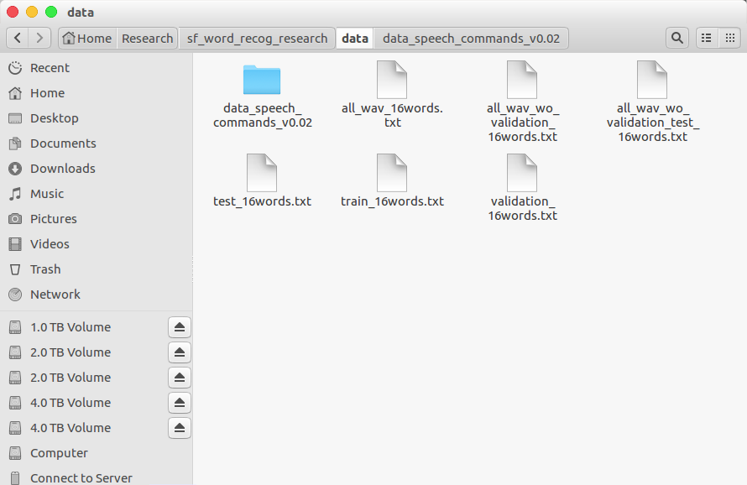
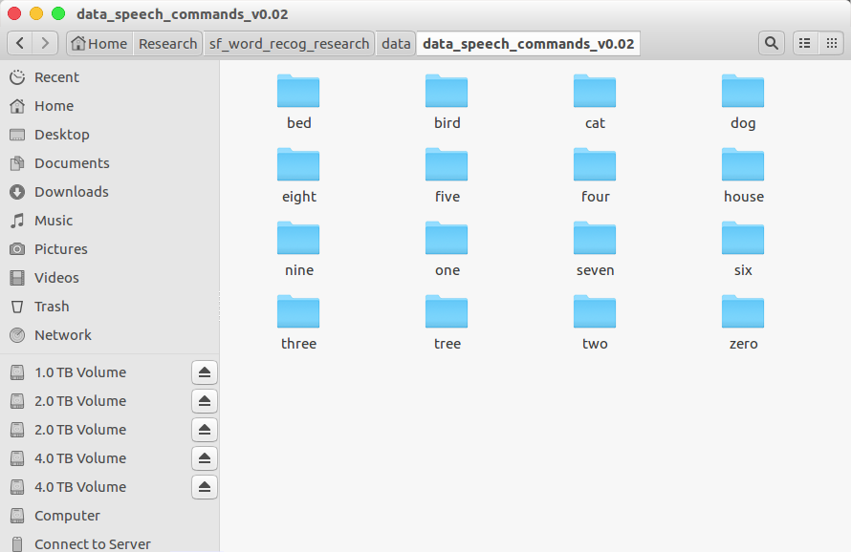
Audio Classification - Previous Work
Data is low-waveform.
sec: 1, sampling rate: 16000, type: float32, channel: mono
16 class data.
'zero', 'one', 'two', 'three', 'four', 'five', 'six', 'seven', 'eight', 'nine', 'bed', 'bird', 'tree', 'cat', 'house', 'dog'
Train: 40851(≒80%), Validation: 4796(≒10%), Test: 5297(≒10%)
- 2 -
Notes:
Supporting facts

Slide 3
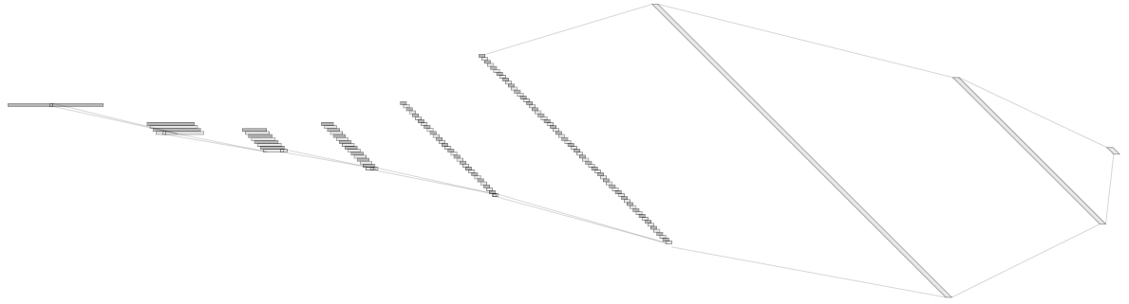
Audio Classification - Previous Work
For example, ‘5Conv, 2FC’ baseline model’s detail.
It just flatten 2D model. (5X5 filter->1X25 filter, 2X2 stride->1X4 stride)
Input: 16000X1 low waveform.
Output:1x16 labeled one hot vector. ('zero', …, 'eight', …, 'house', 'dog')
Loss: cross entropy loss
Obtimizer: Adam
Channel@DataSize
1X1024
128@8
1X512
1@16000
64@55
8@3994
16@993
32@243
Conv(25)
MaxPool(4)
1X16
Conv(25)
MaxPool(4)
Conv(25)
MaxPool(4)
Conv(25)
MaxPool(4)
Conv(25)
MaxPool(4)
Fully-Conncted
Fully-Conncted
[ Baseline Architecture]
- 3 -
Notes:
Supporting facts

Slide 4
Audio Classification - Previous Work
Fine tuning task in 1D-CNN
0. Depth
8. Dropout rate
9. Kernel Size
1. Dropout
2. Batch Normalization
3. D·O + B·N
10. Summary
11. Finetune based on good model
4. Reduce FC
12. Change the channel more steeply
5. Channel
6. Kernel Size
13. Change the channel to become smaller and smaller
7. Summary
Previous Work
- 4 -
Notes:
Supporting facts

Slide 5
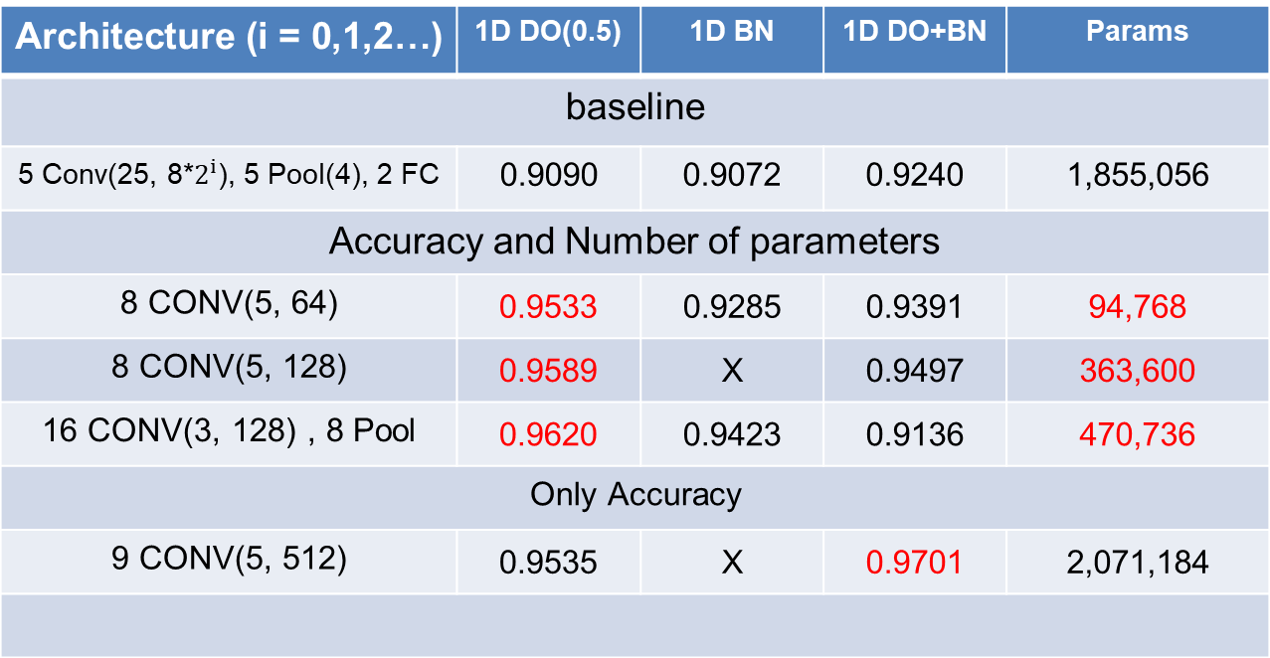
Audio Classification - Previous Work
This is SOTA(State Of The Art) in current research.
Architecture (i = 0,1,2…) | 1D DO(0.5) | 1D BN | 1D DO+BN | Params
baseline
5 Conv(25, 8*$2^{i}$), 5 Pool(4), 2 FC | 0.9090 | 0.9072 | 0.9240 | 1,855,056
Accuracy and Number of parameters
8 CONV(5, 64) | 0.9533 | 0.9285 | 0.9391 | 94,768
8 CONV(5, 128) | 0.9589 | X | 0.9497 | 363,600
16 CONV(3, 128) , 8 Pool | 0.9620 | 0.9423 | 0.9136 | 470,736
Only Accuracy
9 CONV(5, 512) | 0.9535 | X | 0.9701 | 2,071,184
base model
Custom
channel 32
DO(0.75)
Custom
channel 64
DO(0.75)
Custom
VGG style
DO(0.75)
Custom
channel 128
DO(0.25)+BN
- 5 -
Notes:
Supporting facts

Slide 6
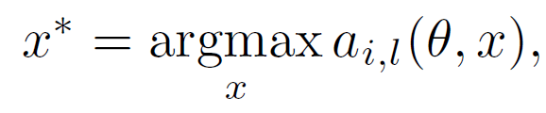
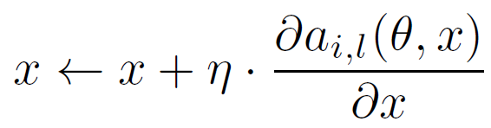
Activation Maximization
Synthesize an input pattern image that can maximize a specific neurons activation in arbitrary layers.
The preferred input can indicate what features of a neuron has learned.
a: filter
i: layer index
l: filter index
θ: weight, bias
x: input noise image
η: learning rate
(if η is low => focus on texture)
(if η is high => focus on shape)
- 6 -
Notes:
Supporting facts

Slide 7

AM – Pretrained Model (VGG 16)
Input: imagenet data (224*224*3)
Output: 1000 class (ex. zebra, slug, hen, gold fish, etc… )
- 7 -
Notes:
Supporting facts

Slide 8
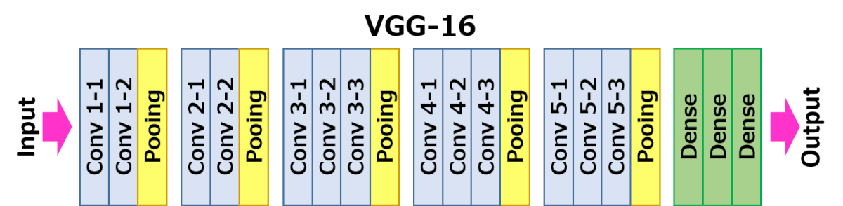
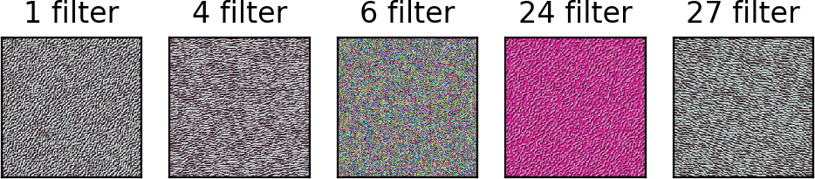
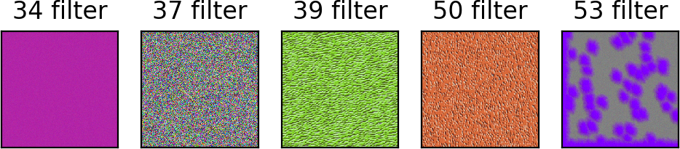
AM – 1th Conv layer (VGG 16)
- 8 -
Notes:
Supporting facts

Slide 9
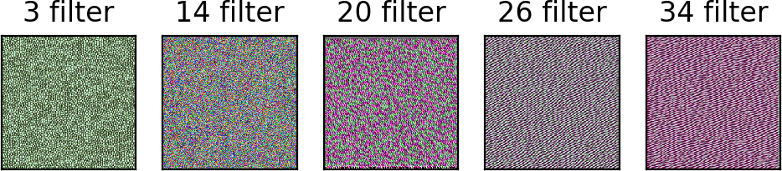
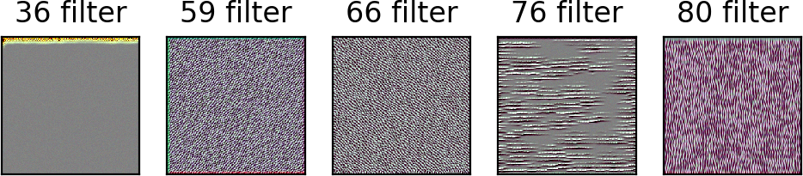
AM – 2th Conv layer (VGG 16)
- 9 -
Notes:
Supporting facts

Slide 10
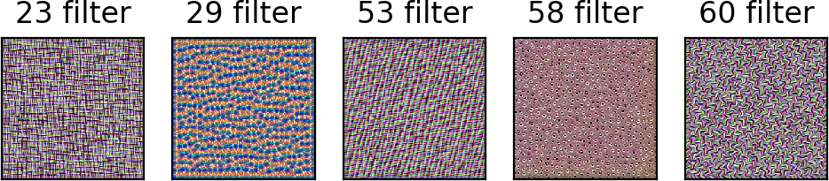
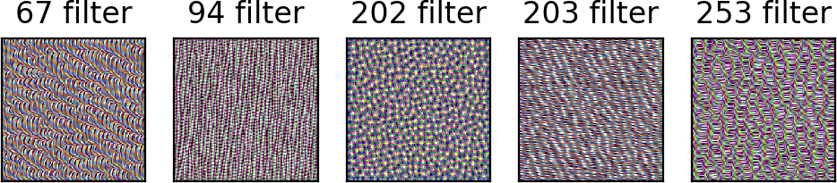
AM – 3th Conv layer (VGG 16)
- 10 -
Notes:
Supporting facts

Slide 11
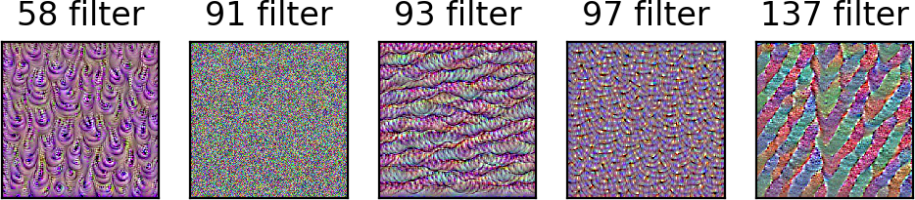
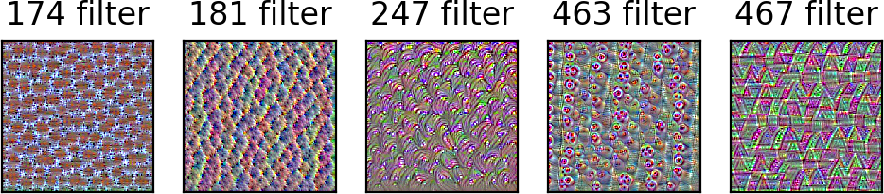
AM – 4th Conv layer (VGG 16)
- 11 -
Notes:
Supporting facts

Slide 12
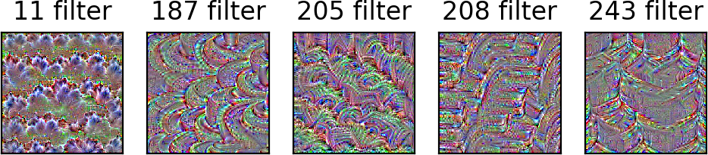
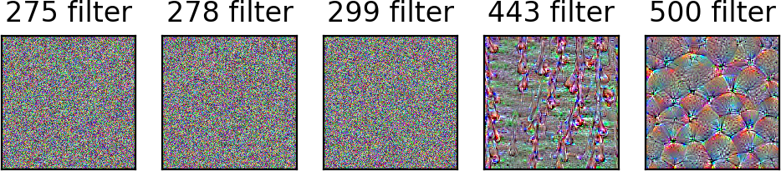
AM – 5th Conv layer (VGG 16)
- 12 -
Notes:
Supporting facts

Slide 13
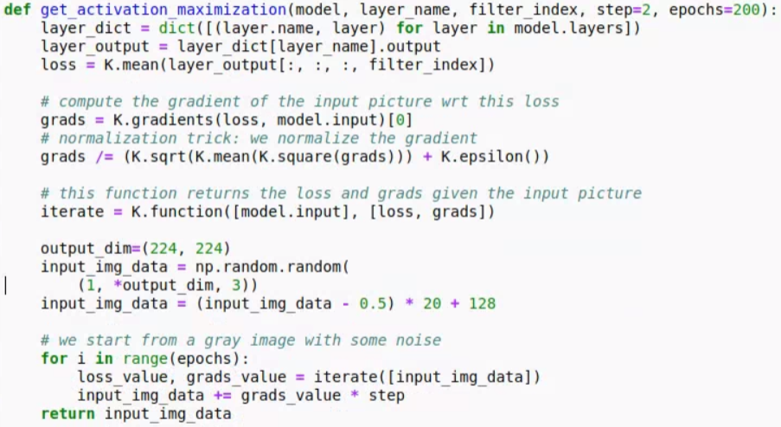
AM – Evaluate (implement)
Synthesize an input pattern image that can maximize a specific neurons activation in arbitrary layers.
The preferred input can indicate what features of a neuron has learned.
- 13 -
Notes:
Supporting facts

Slide 14
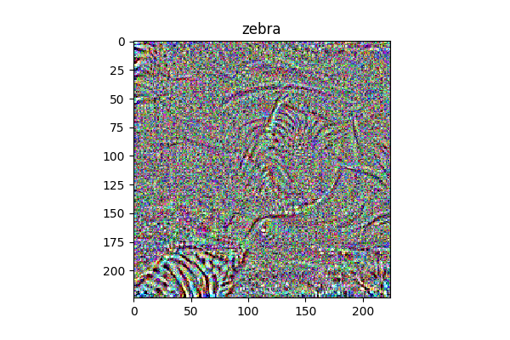
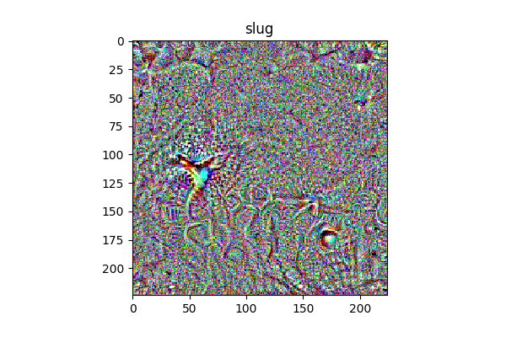
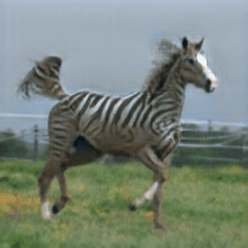
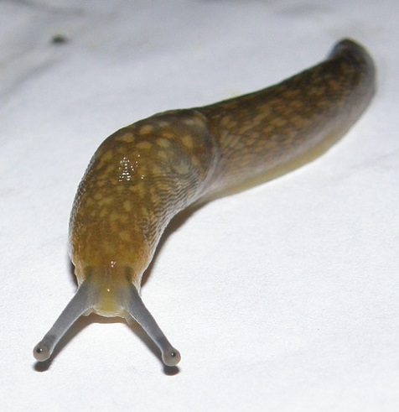
AM – Evaluate (Softmax)
In Softmax layer, if target node’s activation is higher, that is representation of target label
- 14 -
Notes:
Supporting facts

Slide 15
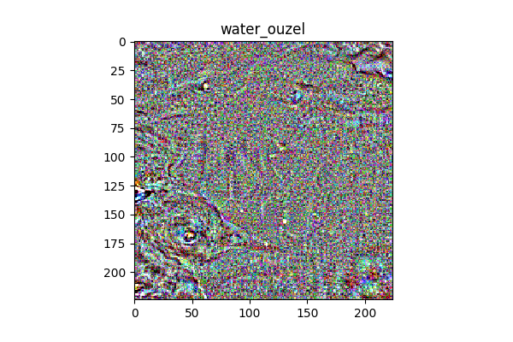
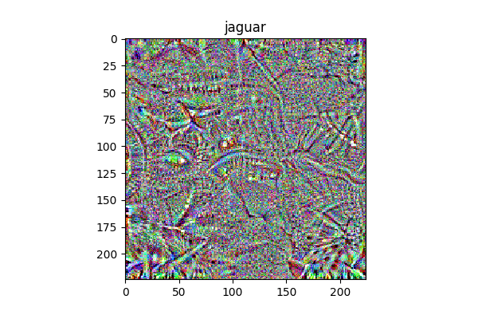
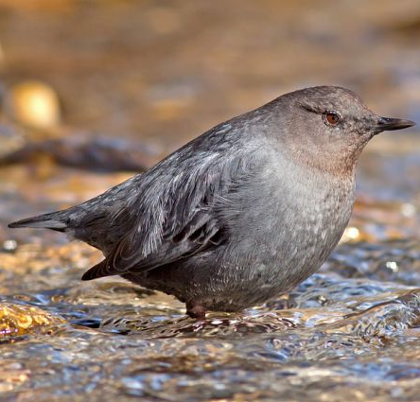
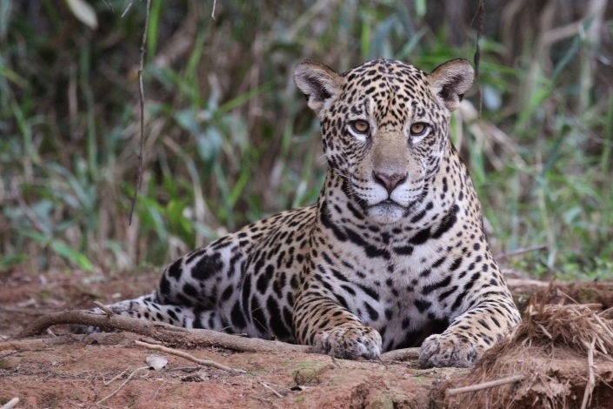
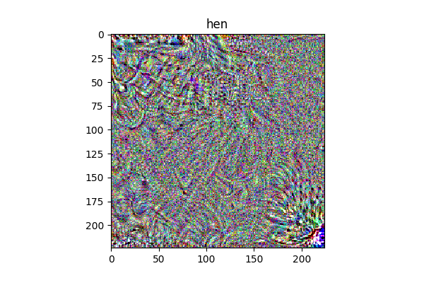
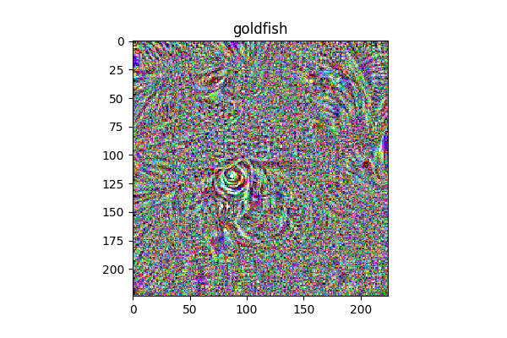
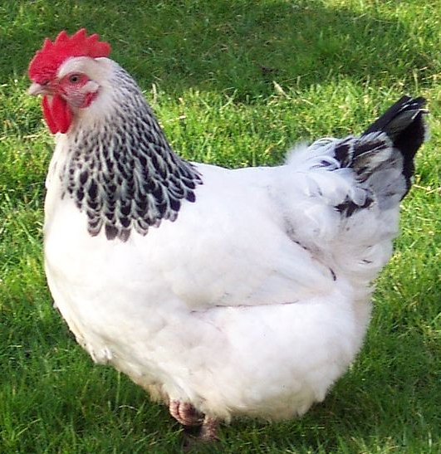
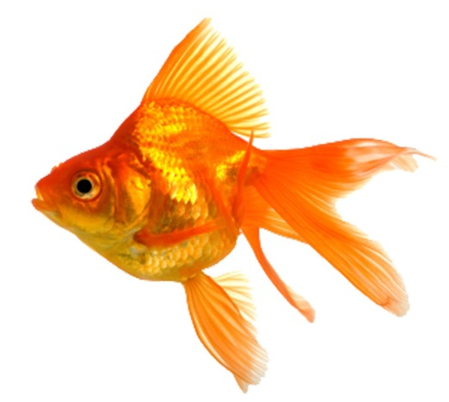
AM – Evaluate (Softmax)
In Softmax layer, if target node’s activation is higher, that is representation of target label
- 15 -
Notes:
Supporting facts

Slide 16
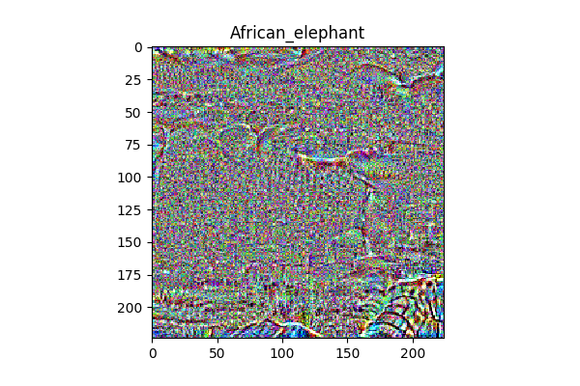
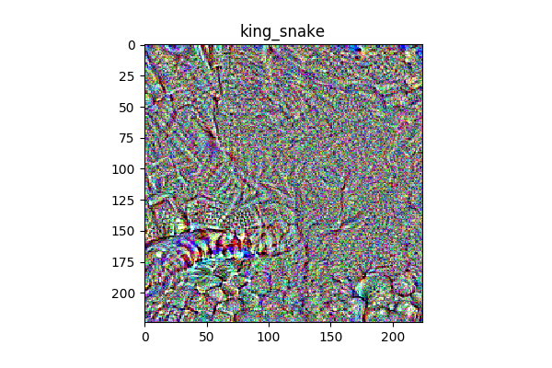
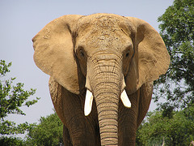
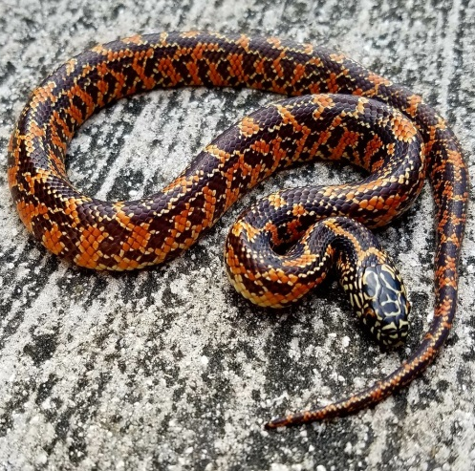
AM – Evaluate (Softmax)
We can find each pattern or shape or both.
But, Is it well done…?
The most of result is not clear.
- 16 -
Notes:
Supporting facts

Slide 17
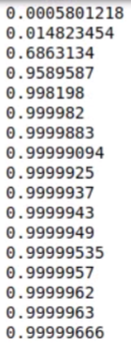
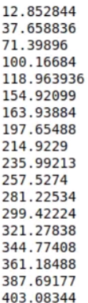
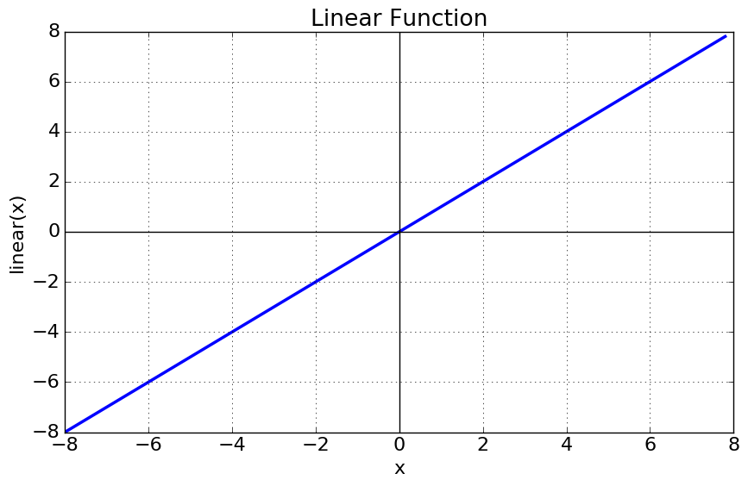
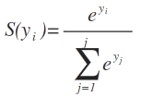
AM – Evaluate (Softmax To Linear)
<Loss>
< Softmax (0≤ y≤1) >
< Linear (-inf＜ y ＜ inf) >
<Loss>
Because of softmax range, Image is no longer updated
To solve this, Change Softmax function to Linear function (It’s Just trick)
- 17 -
Notes:
Supporting facts

Slide 18
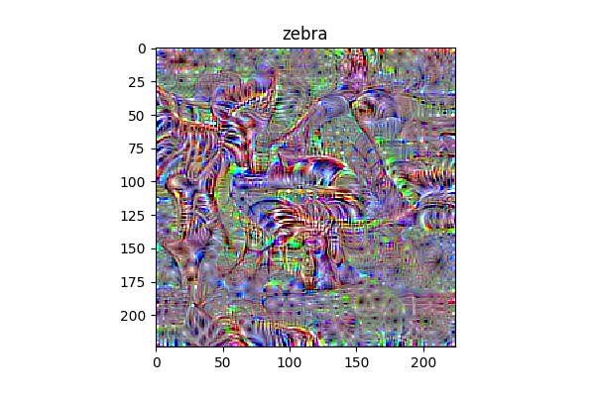
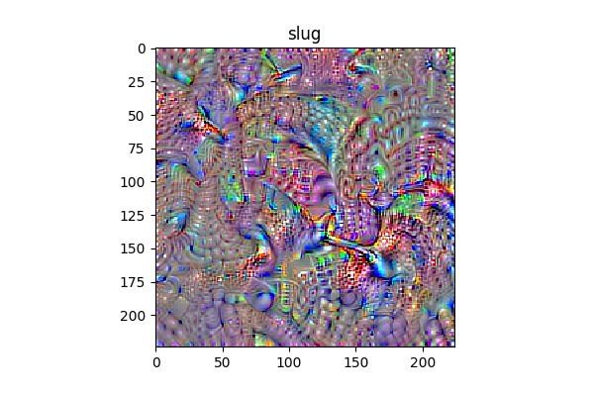
AM – Evaluate (Softmax To Linear)
- 18 -
Notes:
Supporting facts

Slide 19
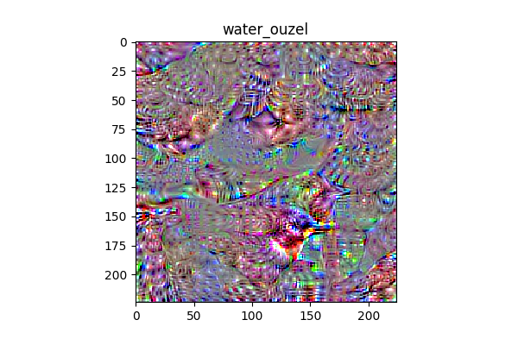
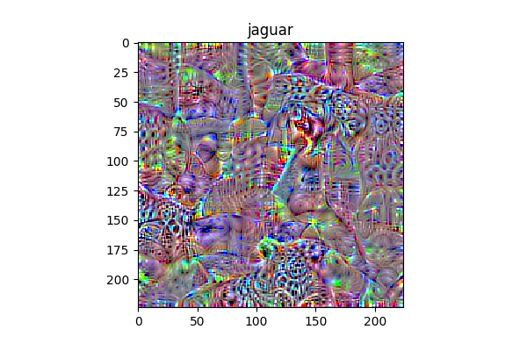

AM – Evaluate (Softmax To Linear)
- 19 -
Notes:
Supporting facts

Slide 20
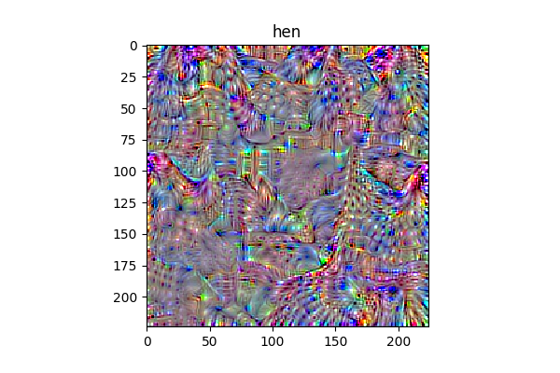
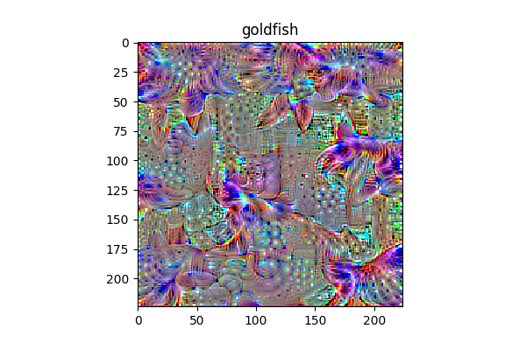

AM – Evaluate (Softmax To Linear)
- 20 -
Notes:
Supporting facts

Slide 21
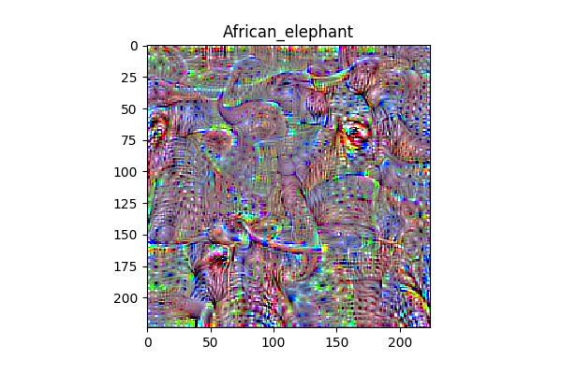
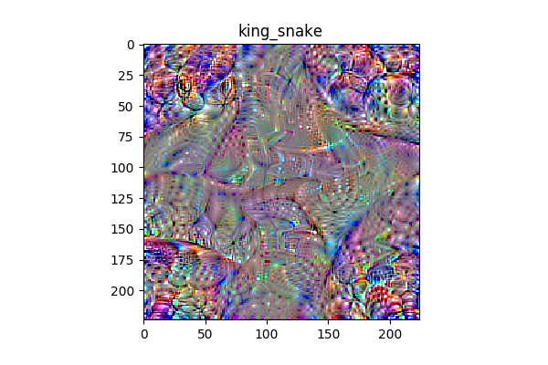

AM – Evaluate (Softmax To Linear)
- 21 -
Notes:
Supporting facts

Slide 22
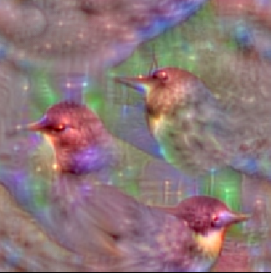
To the next level
There are many ways to improve the quality of visualization.
Zitter
Regularization (L1, L2… Lp space)
TotalVariation
GAN
< Current result >
< Our goal>
- 22 -
Notes:
Supporting facts

Slide 23
Any Question?
Thank you
Notes:
Supporting facts

